Slide 1
BRIGHTLINE
BES (BULK ELECTRIC SYSTEM) INITIATIVE: ITHACA LINE 981
NYSEG PUBLIC OUTREACH
June 12, 2019

Slide 2
AGENDA
  Introductions
  Brightline BES Initiative Overview
  Ithaca Line 981 Fact Sheet, Details, Landowner Communication and Timeline (Handouts)
  Community Benefits
  Questions
BRIGHTLINE
BES (BULK ELECTRIC SYSTEM) INITIATIVE:
ITHACA LINE 981

Slide 3
INTRODUCTION
  Bob Pass – NYSEG Manager: Community Outreach & Development
  Stacy Bartl – NYSEG and RG&E Public Outreach
  Olivia Guevara – Avangrid Project Manager
  Ben Virts – Permitting Manager, Brightline BES Program
BRIGHTLINE
BES (BULK ELECTRIC SYSTEM) INITIATIVE:
ITHACA LINE 981

Slide 4
BRIGHTLINE BES INITIATIVE
  In 2010, the Federal Energy Regulatory Commission (FERC) established a “Brightline” threshold that redefined Bulk Electric System (BES) elements. In response, the North American Electric Reliability Corporation (NERC ) updated its reliability standards.
  As a result, the Brightline BES (Bulk Electric System ) Initiative was enacted: a multi-year NYSEG electric transmission system upgrade program that will ensure compliance with mandatory reliability requirements.
  As part of our commitment to provide safe, reliable service to all of our customers, NYSEG is updating our delivery system in our service areas.
BRIGHTLINE
BES (BULK ELECTRIC SYSTEM) INITIATIVE:
ITHACA LINE 981

Slide 5
  BRIGHTLINE BES INITIATIVE
  Electricity plays a critical role in achieving a clean energy economy. NYSEG is investing in upgrades to meet the community’s growing energy demands. The Brightline BES Initiative projects will create a more reliable and resilient energy grid that will meet the growing needs of our communities and the energy demands of the economy. Our company is working closely with its neighbors to ensure that improvements are performed safely and with minimal disruption to the environment and the communities we serve.
BRIGHTLINE
BES (BULK ELECTRIC SYSTEM) INITIATIVE:
ITHACA LINE 981

Slide 6
BRIGHTLINE BES INITIATIVE LINE 981 - SCOPE
The areas between the Coddington and Etna Roads as well as parts of the East Ithaca area are in need of various upgrades to comply with new federal electric transmission reliability requirements. The project includes replacing wood poles with steel structures, and the installation of larger more durable poles. In addition, our crews will replace six miles of optical grounding wire (OPGW) between Etna and Coddington. There will also be three miles of conductor replacement in order to increase overall load capacity.
BRIGHTLINE
BES (BULK ELECTRIC SYSTEM) INITIATIVE:
ITHACA LINE 981

Slide 7
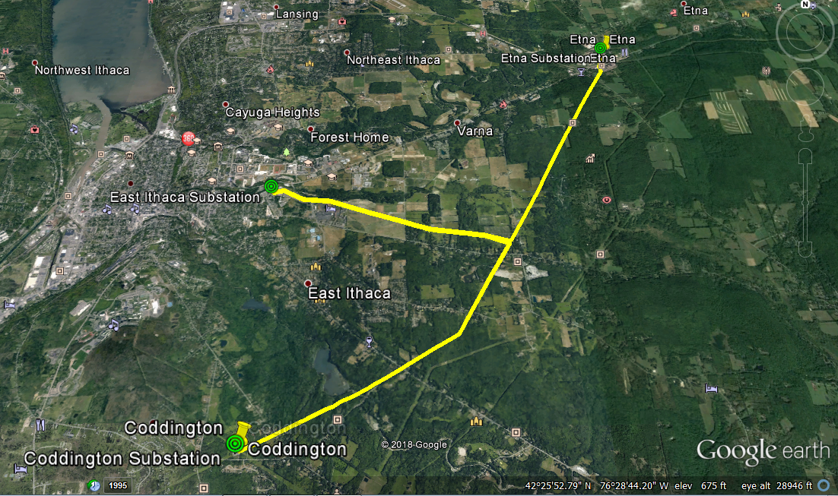
BRIGHTLINE BES INITIATIVE LINE 981: GOOGLE EARTH KMZ
BRIGHTLINE
BES (BULK ELECTRIC SYSTEM) INITIATIVE:
ITHACA LINE 981

Slide 8
BRIGHTLINE BES INITIATIVE LINE 981: DETAILS
  Line 981 is an existing 115 kV transmission line, approximately 11 miles long, connecting NYSEG’s Coddington, Etna and East Ithaca substations. The line is a combination of wooden single pole and H-frame pole structures.
  Line 981 upgrades will include the following:
  3 miles: conductor wire replacement;
  6 miles: optical grounding wire (OPGW) replacement supporting grounding and substation communications; and
  As needed pole structure replacements to correct deteriorated condition and achieve line safety clearance initiatives:
    Approx. 25% of existing line structures (40 of 147) will be affected.
    Replacement pole structure material will be steel.
    Pole structure heights will increase at 36 replacement locations.
  Schedule:
  Construction Start: Q3-Q4 2020
  In-Service Date: Q3-Q4 2020
BRIGHTLINE
BES (BULK ELECTRIC SYSTEM) INITIATIVE:
ITHACA LINE 981

Slide 9
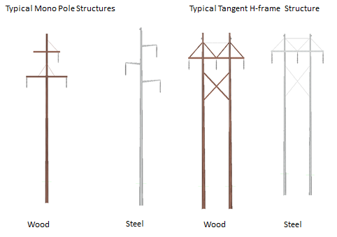
BRIGHTLINE BES INITIATIVE LINE 981: POLE REPLACEMENTS
BRIGHTLINE
BES (BULK ELECTRIC SYSTEM) INITIATIVE:
ITHACA LINE 981

Slide 10
FOR THE COMMUNITY
The BES upgrades will positively impact the Ithaca area
by providing:
A stronger, smarter energy grid.
A more reliable, resilient and safe electric system that can support future renewable energy.
The infrastructure to meet the reliability and growing needs of our communities and the energy demands of the economy.
Continuous outstanding service to homes and businesses in the area well into the future.
BRIGHTLINE
BES (BULK ELECTRIC SYSTEM) INITIATIVE:
ITHACA LINE 981

Slide 11
NEXT STEPS
There will be minimal change in our environmental impact. Existing Rights of Way (ROW) are intact.
Landowners affected by this effort will receive a letter in the next few days informing them of the planned upgrades. After that, and in the upcoming weeks, a representative from NYSEG or contractors working on behalf of the company will be contacting those same landowners directly regarding these changes and any potential impact on their property. In the meantime, if they have any questions about the project, they can call us at 833-551-4200.
BRIGHTLINE
BES (BULK ELECTRIC SYSTEM) INITIATIVE:
ITHACA LINE 981

Slide 12
OUR COMMITMENT
  NYSEG’s core goal is to provide safe and reliable energy for our customers. Our company thrives on being a considerate neighbor and committed community partner, and we will work collaboratively with landowners, community leaders and regulators throughout this upgrade process.
BRIGHTLINE
BES (BULK ELECTRIC SYSTEM) INITIATIVE:
ITHACA LINE 981

Slide 13

Questions

